Slide 1


Predictive Analysis of Term Deposit Subscriptions
Team Members
Tushar Ahuja
Srinivas Allanki
Mihirateja Narvaneni

Slide 2

Introduction
Overview of the Project
Objective:
Analyze factors influencing term deposit subscriptions during telemarketing campaigns by a Portuguese bank.
Importance:
Understanding these factors can help optimize marketing strategies and improve client targeting.

Slide 3

A term deposit is a fixed investment where money is deposited for a set period at a guaranteed interest rate. It offers predictable returns but penalties apply for early withdrawal. Term deposits are considered low-risk, secure investments.

Slide 4
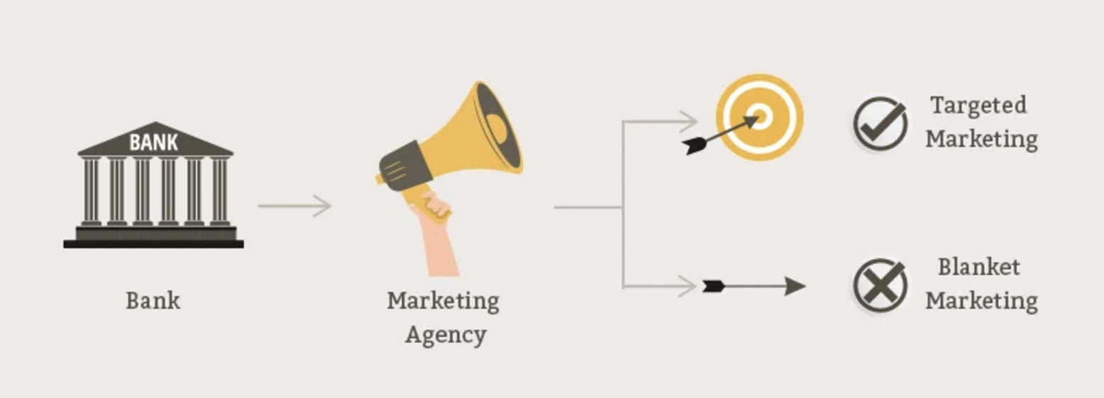
The Power of Targeted Marketing in Banking
This diagram contrasts two marketing approaches in banking:
Targeted Marketing (✔️): Data-driven, focused efforts to reach specific customer segments, symbolized by an arrow hitting the bullseye.
Blanket Marketing (❌): Broad, undifferentiated outreach, shown by an arrow missing the target. Targeted marketing is preferred for its higher ROI and efficiency.

Slide 5

Dataset Overview
Source: UCI Machine Learning Repository
Time Period: Data collected from 2008 to 2010.
Size: 45,211 observations with 17 variables.
Purpose: Predict client subscriptions and enhance marketing strategies.
Type of Study: Observational study capturing real-world behaviors without experimental manipulation.

Slide 6
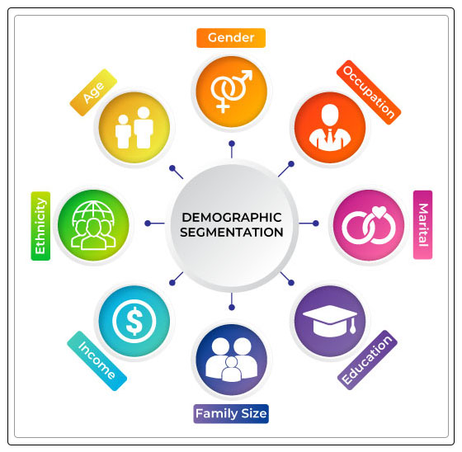
Key Variables
Dependent Variable:
Subscription Status (y): Binary outcome (yes/no).
Independent Variables:
Client Demographics: Age, job, marital status, education.
Financial Information: Balance, previous campaign outcomes.
Campaign Details: Contact type, last contact duration, timing.

Slide 7
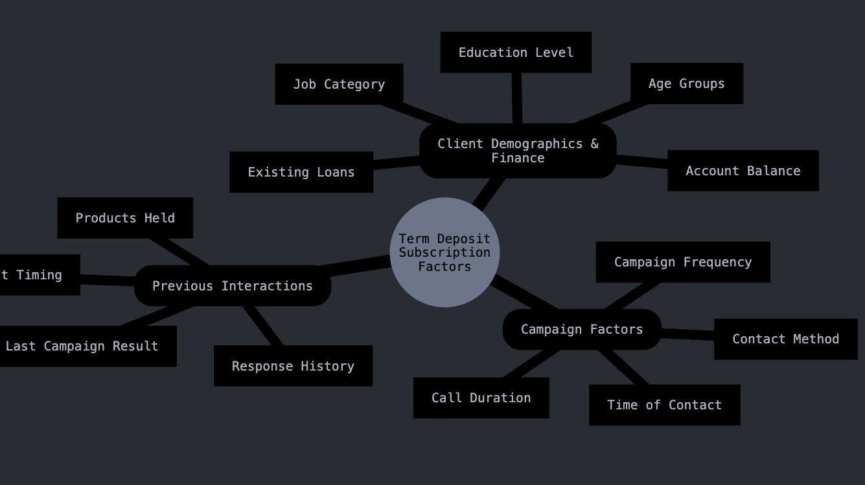
Research Questions
What client demographic and financial attributes are most predictive of a term deposit subscription?
Which campaign-related factors are associated with higher subscription rates?
How do previous campaign interactions affect subscription likelihood?

Slide 8

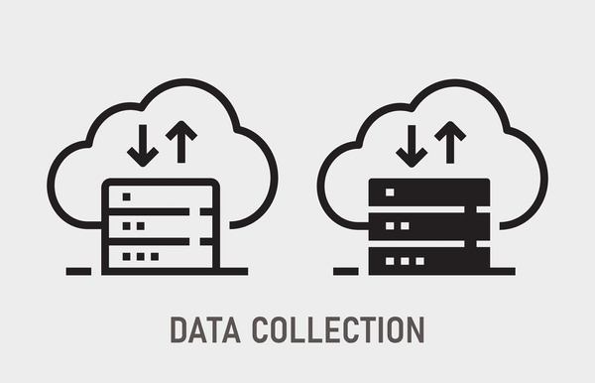
Data Acquisition and Preparation
Loading the Data
Dataset loaded from Portuguese Banking Institution's campaign data.
Key columns: Age, Job, Marital Status, Balance, etc.
Outlier Handling:
Boxplot of Balance before and after capping to reduce skewness.
Feature Scaling
Standardized numerical features for consistency.
Final Dataset
Cleaned dataset preview to highlight readiness for analysis.

Slide 9
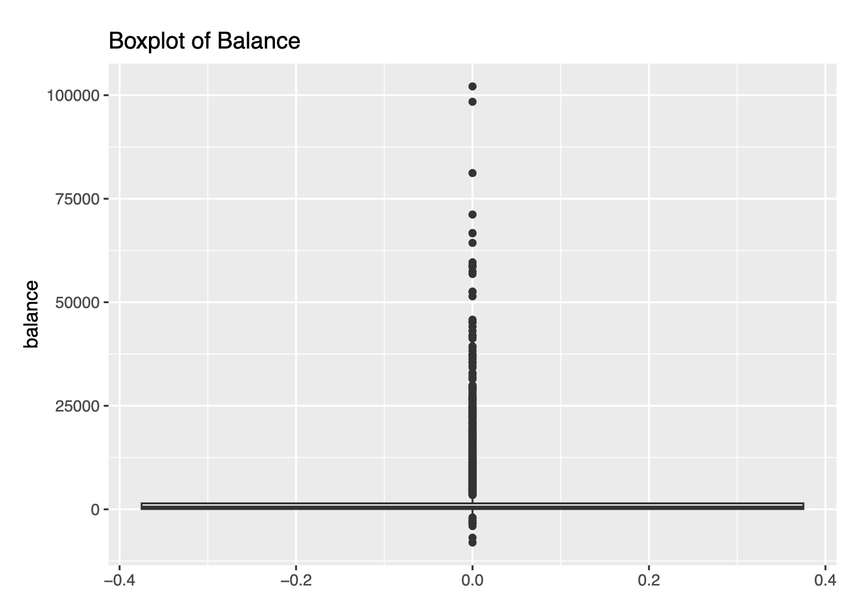
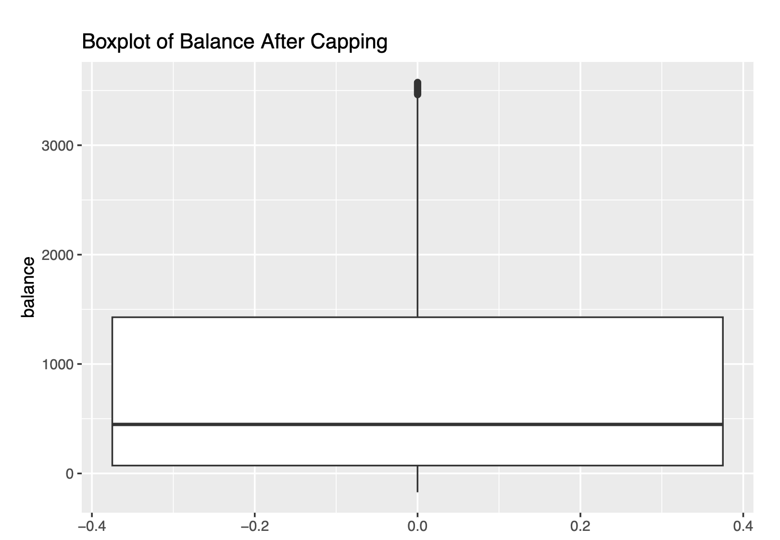
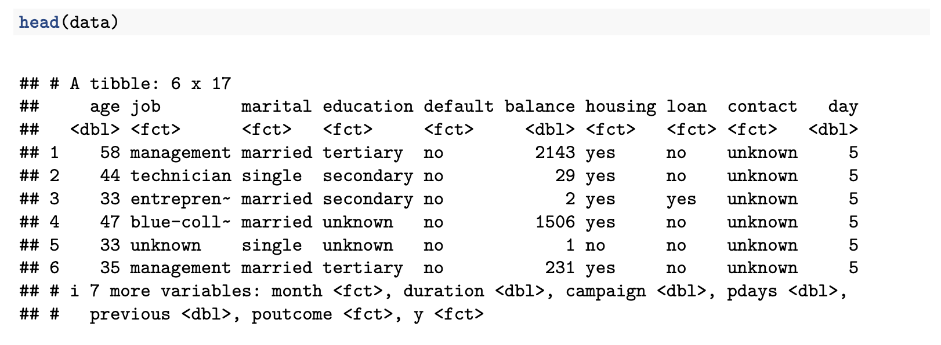
Overview:
Boxplot of Balance (Before and After Capping).
Small table snippet of cleaned data for illustration.

Slide 10
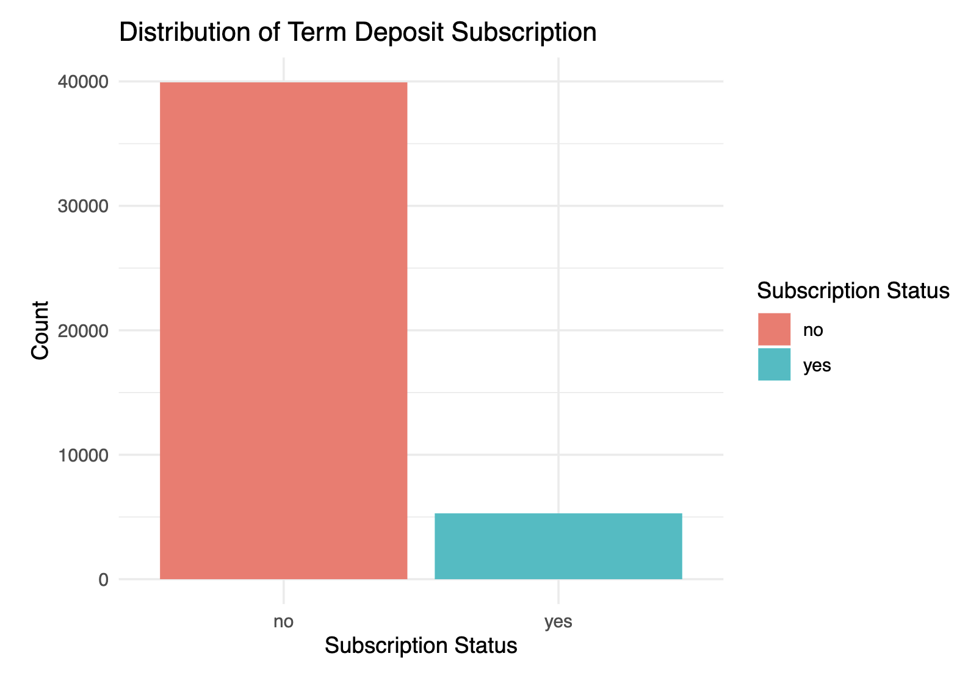
Exploratory Data Analysis
Dependent Variable (y):
Distribution shows imbalanced classes, with fewer term deposit subscriptions.

Slide 11
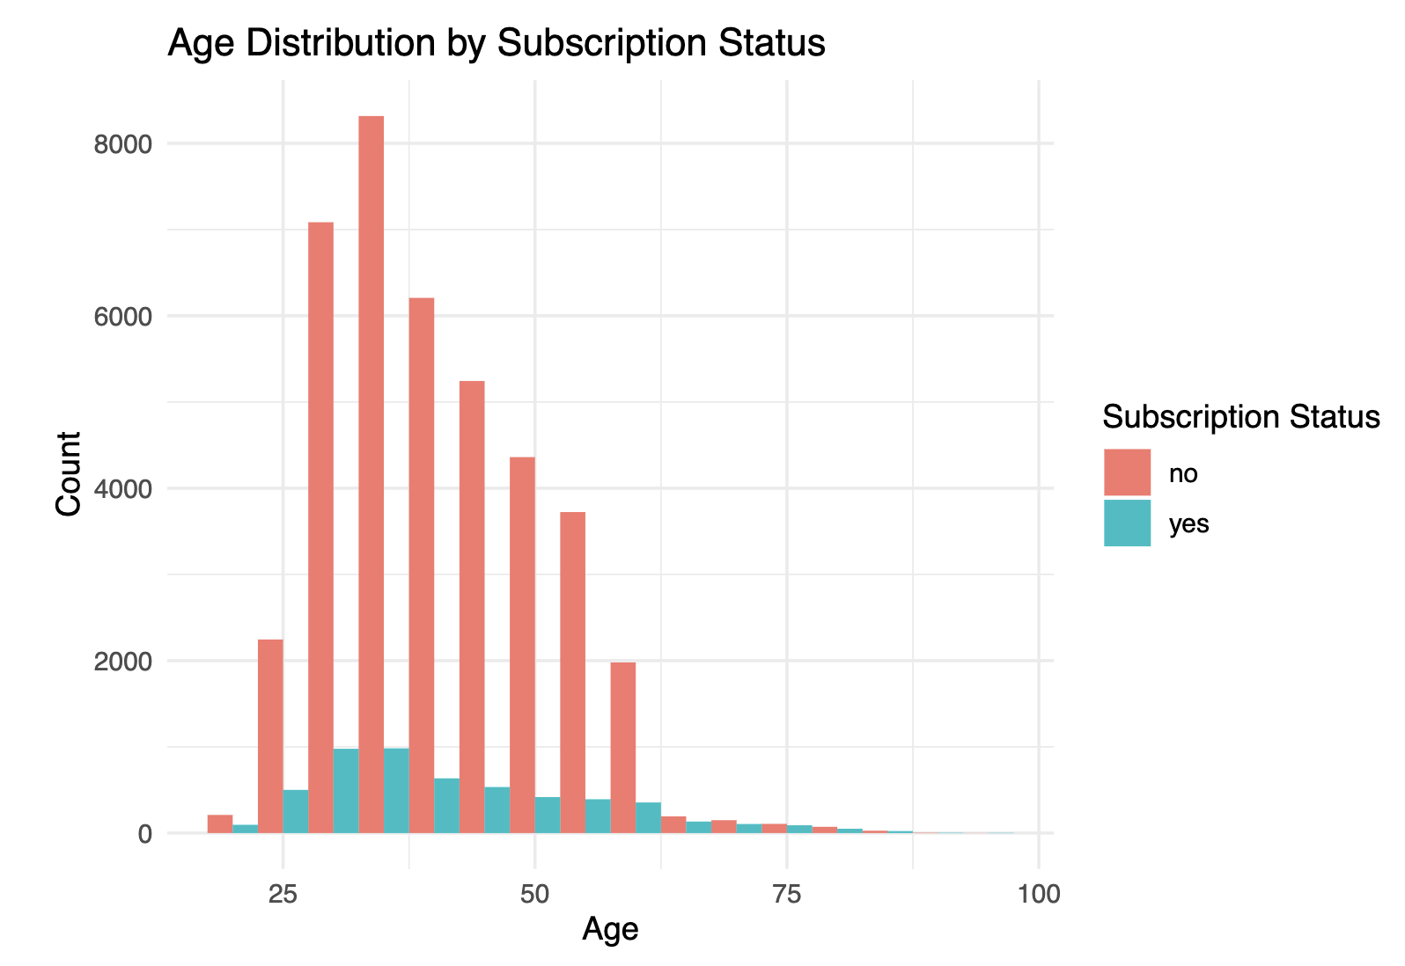
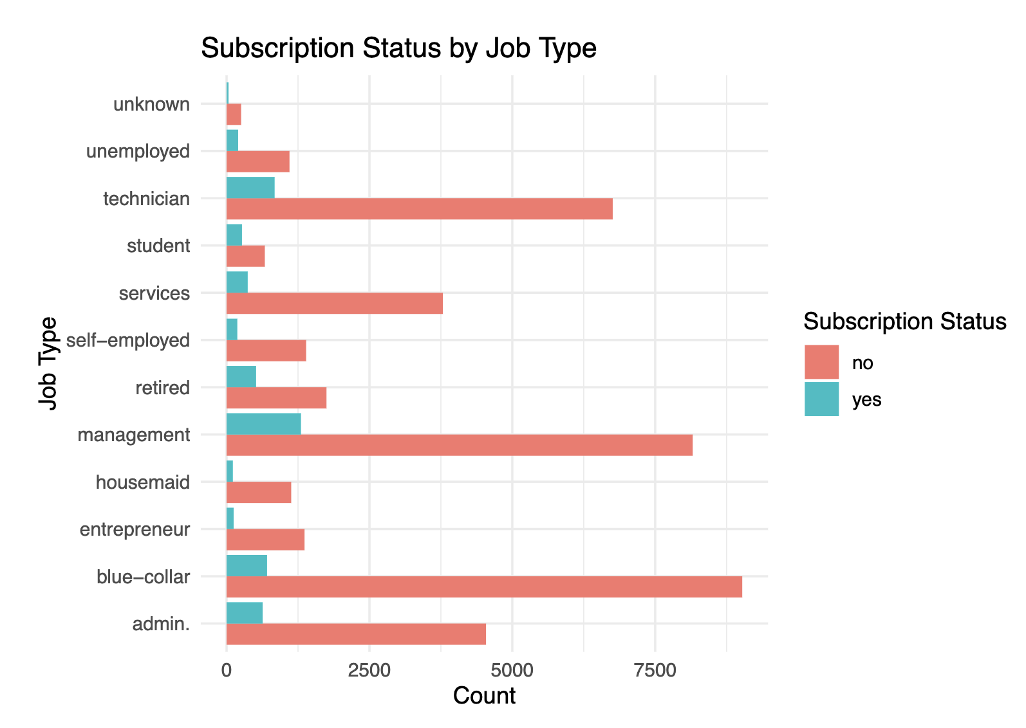
Key Insights:
Age Distribution by Subscription Status: Younger and older clients are having subscription rate.
Subscription Status by Job Type: Students and retired individuals have higher subscription rate.

Slide 12
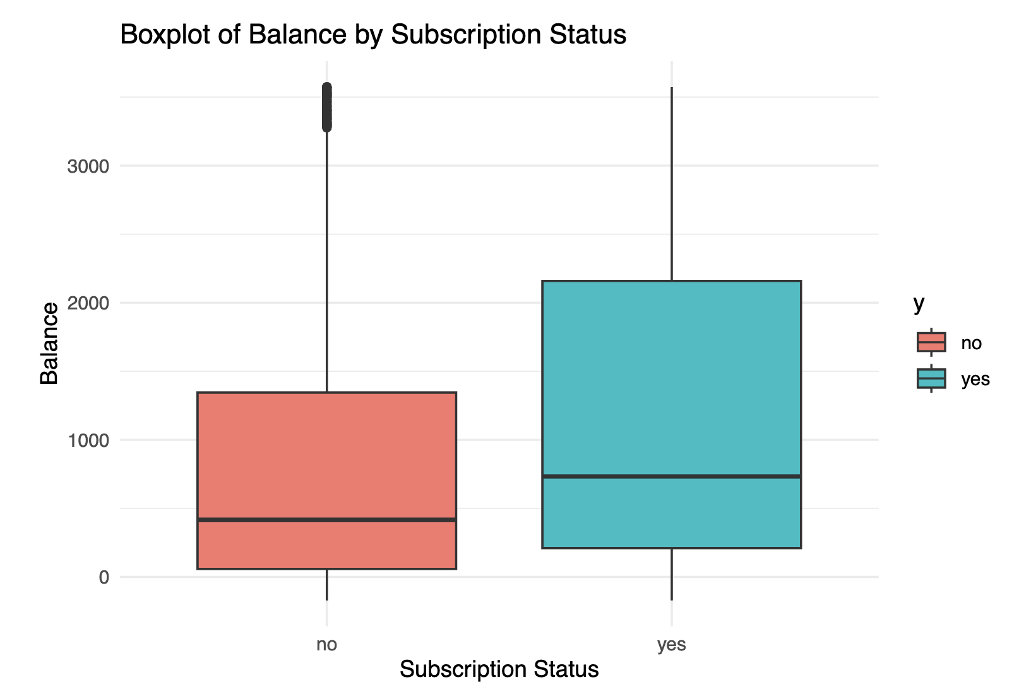
Higher balance individuals are more likely to subscribe.

Slide 13
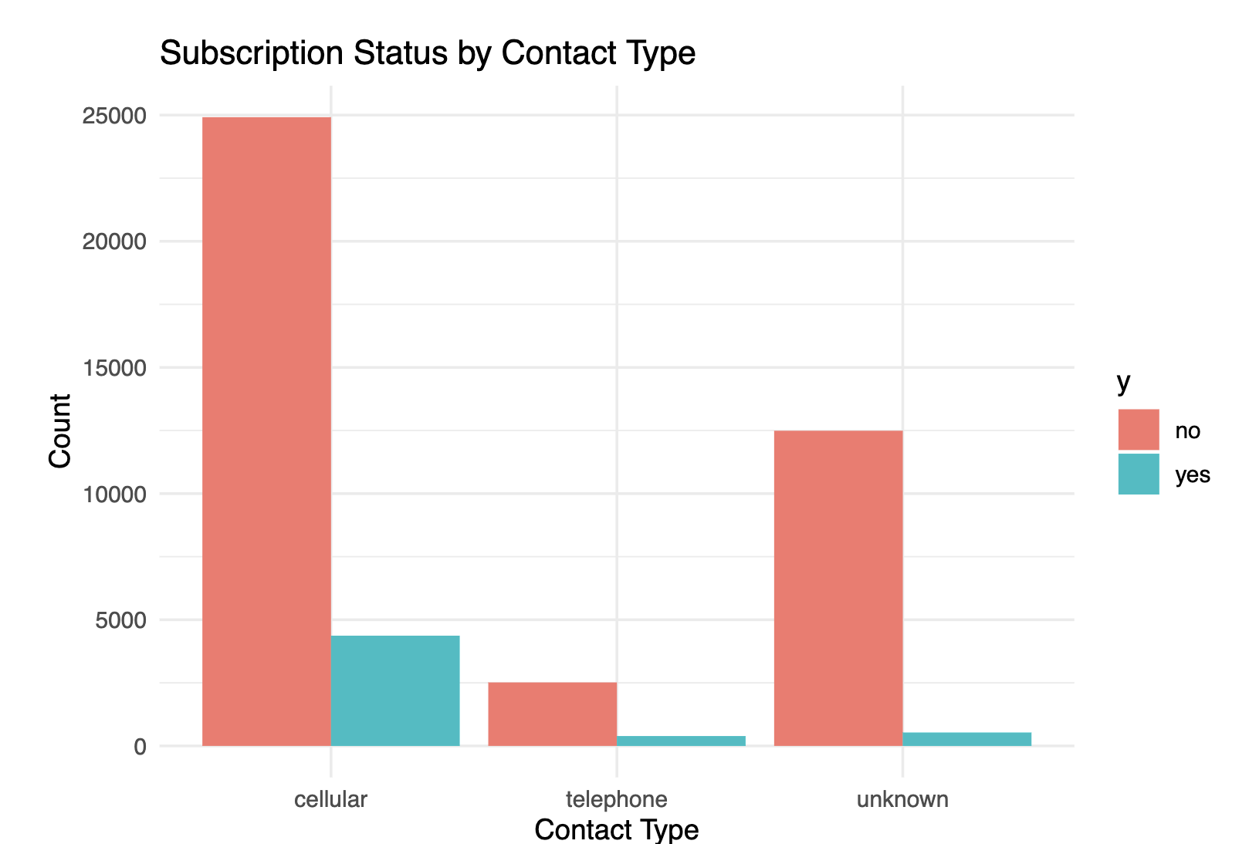
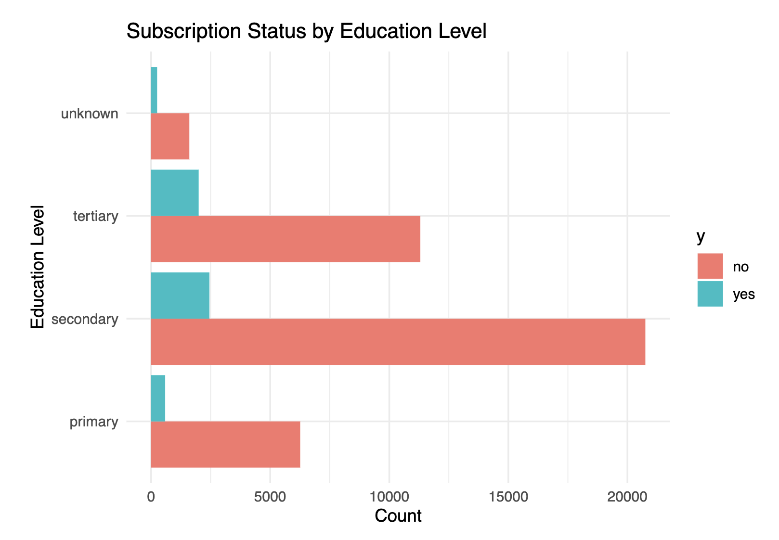
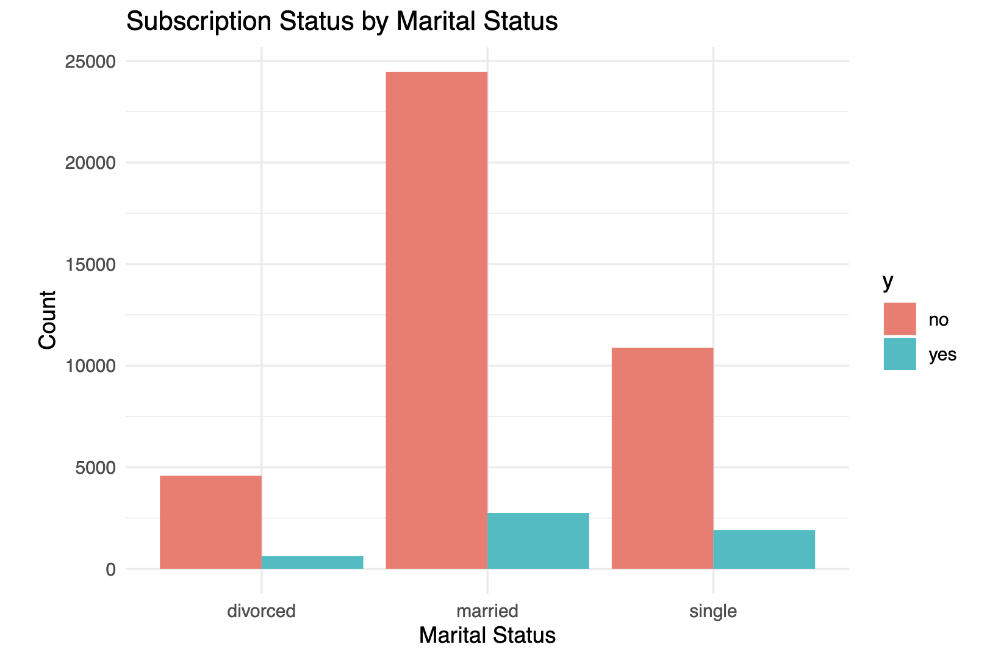
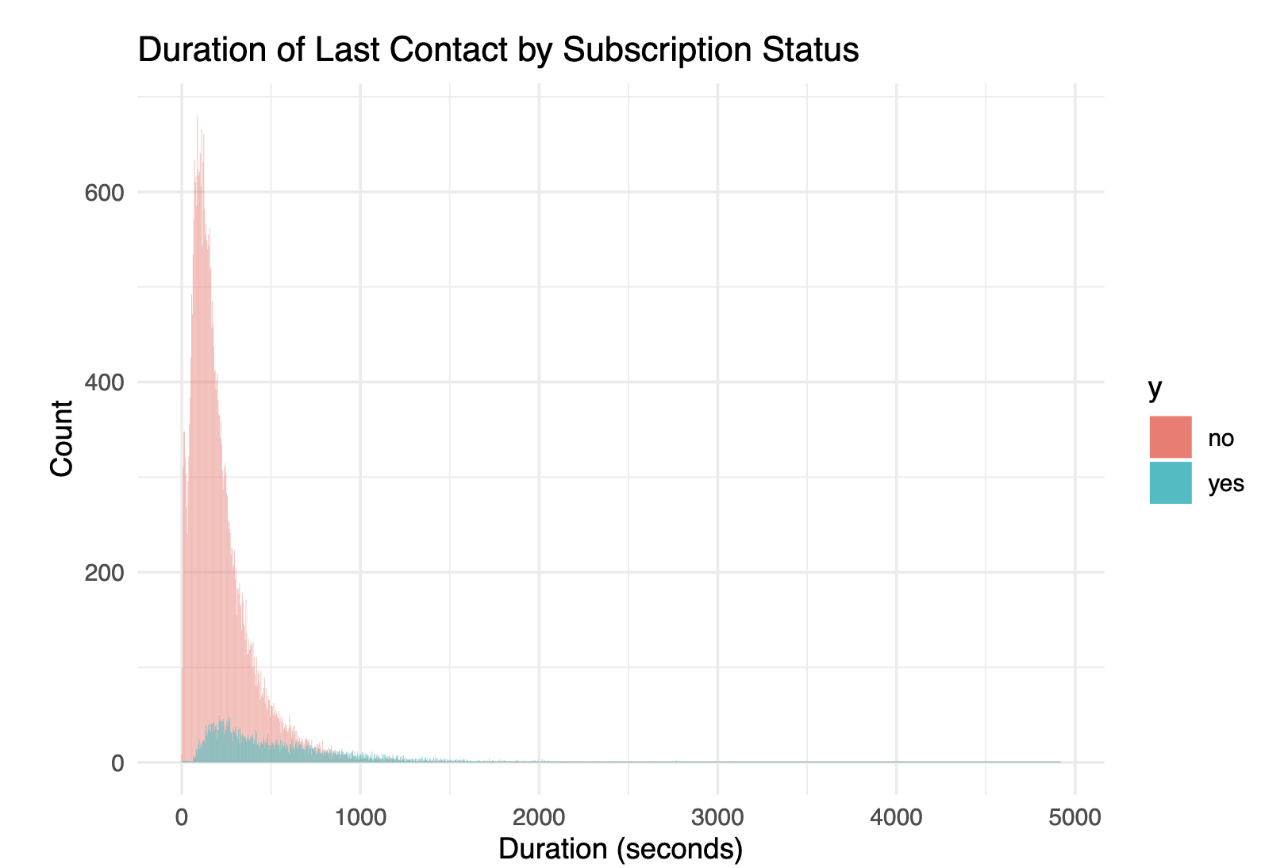
Additional Key Insights
Marital and Education Influence:
Clients with higher education are more likely to subscribe.
Married individuals are more likely to subscribe.
Last Contact Analysis:
Shorter and high quality calls are more effective.

Slide 14
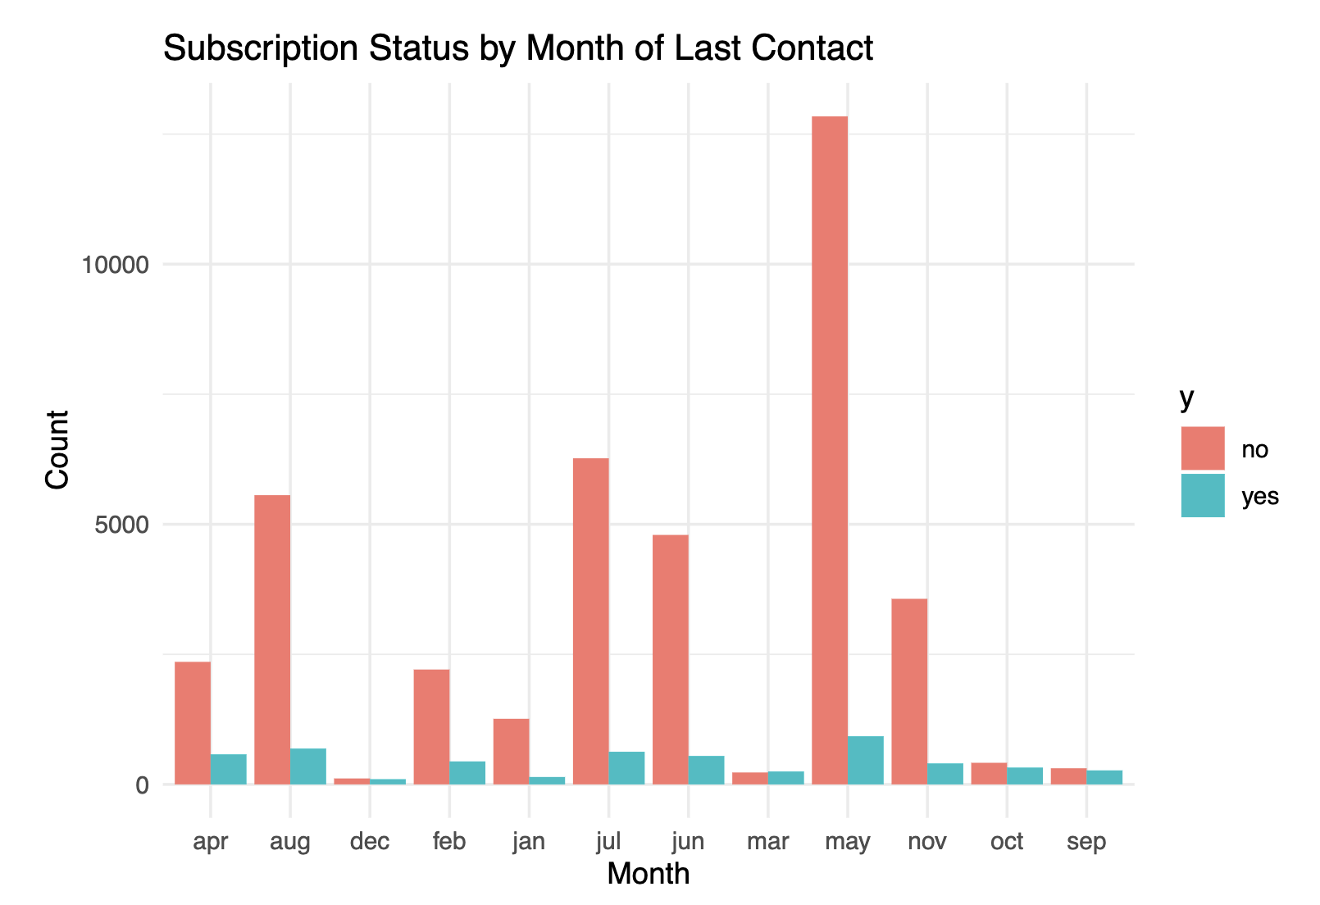
May having high activity but low effectiveness. Months such as September, October, and December have very low contact volumes. These months could be explored further to identify potential untapped opportunities.

Slide 15
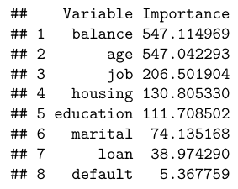

Research Questions
1. What client demographic and financial attributes are most predictive of a term deposit subscription?
- Identify client characteristics influencing subscription rates for targeted outreach.
Clients with higher balances
Retirees and students
Higher education levels (tertiary)
Blue-collar workers and entrepreneurs are less responsive.
Explains ~5% of subscription variance, typical for behavioral models.
Missing external factors (e.g., income) and non-linear relationships.

Slide 16
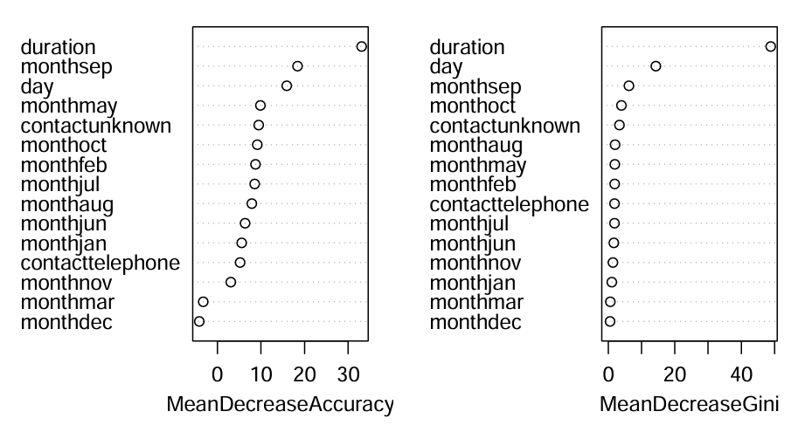
2. Which campaign-related factors are associated with higher subscription rates?
- Discover effective campaign strategies and refine marketing tactics.
High quality shorter duration calls.
High Impact months like October, and September.
Prioritize Cellular Contact Methods.

Slide 17
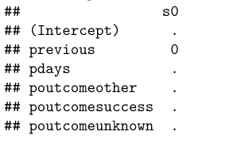
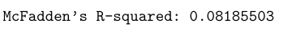
3. How do previous campaign interactions affect the likelihood of a successful subscription?
- Assess the impact of prior interactions to improve follow-up strategies.
Majority of clients had no previous interactions or were contacted a long time ago.
This limits the model's ability to establish meaningful patterns.
Efforts should prioritize re-engaging clients with no prior interactions.

Slide 18
Challenges
The absence of high volume of previous interactions with clients lacked variability. The dominance of an unknown category limited the predictive power.
Low R-squared values highlighted data and model limitations, such as missing features and linear assumptions, requiring better preprocessing and advanced modeling techniques.

Slide 19
Conclusion
The analysis revealed key insights into client demographics, campaign strategies, and past interactions, enabling targeted outreach. Despite challenges like data imbalance, actionable recommendations were identified to optimize subscription rates and campaign effectiveness.
Future work involves incorporating additional client data, exploring advanced models, addressing data imbalance, refining campaign timing, and evaluating multi-channel outreach strategies for improved predictions.

Slide 20
Q&A
Open the floor for questions and discussions.
Thank You !

